Slide 1



Research Data Management: Data Sources and Methods of Data Collection
Sammy Khagayi

Slide 2
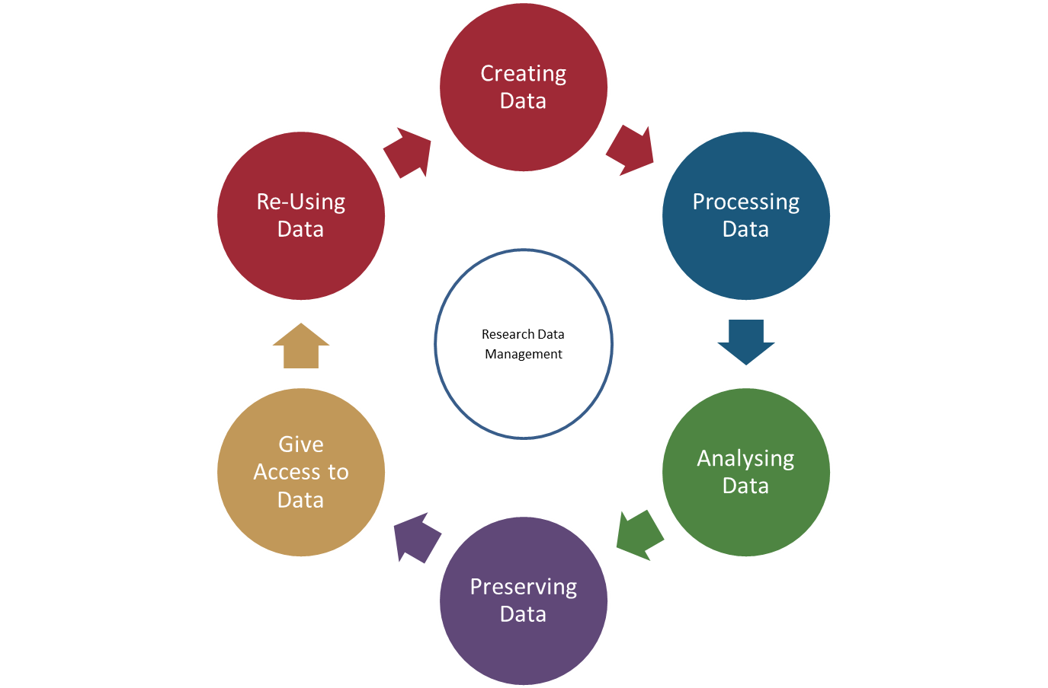
Research data management (RDM) cycle

Slide 3
Sources and methods of data collection

Slide 4
Sources and methods of data collection
Research generates and collects data in different forms, varieties and for different purposes
For proper data management, it's paramount to categorize your data based on the following: - by source - format - permanency/stability - volume.
The category(ies) your data comes from will affect the choices that you make throughout your data management plan

Slide 5
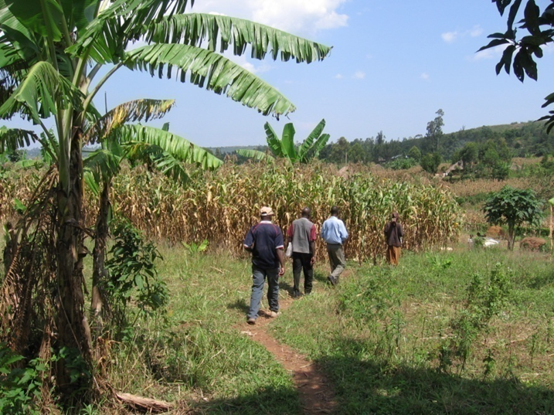
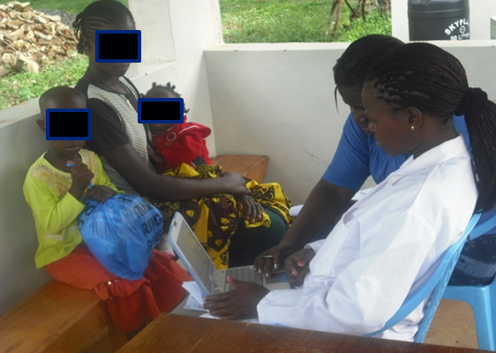
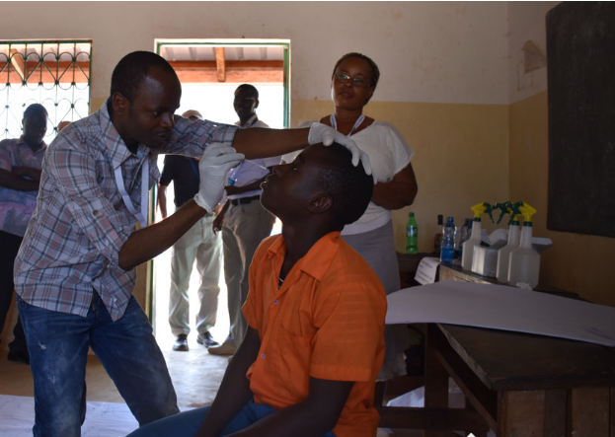
Data source
Observational
Captured in real-time, typically as close as possible to real environment in which events occur
Usually irreplaceable and therefore the most important to safeguard
Examples: Temp readings, body fever, survey results, images

Slide 6
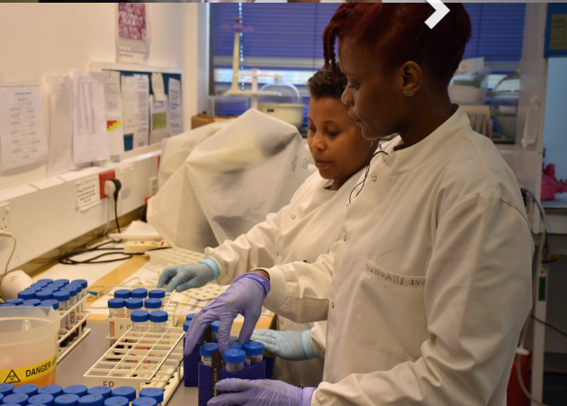
Data source
Experimental
Typically generated in the lab or under controlled conditions
Often reproducible, but can be expensive or time-consuming
Examples: gene sequences, chromatograms, magnetic field readings

Slide 7
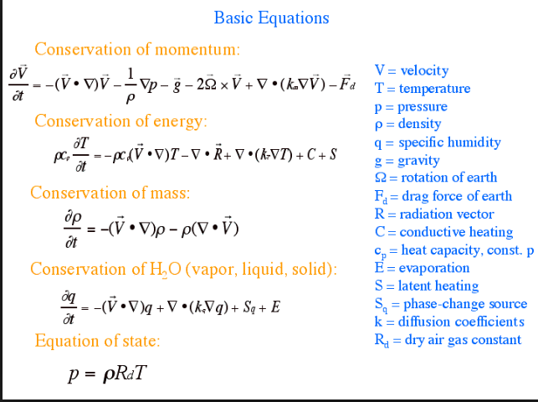
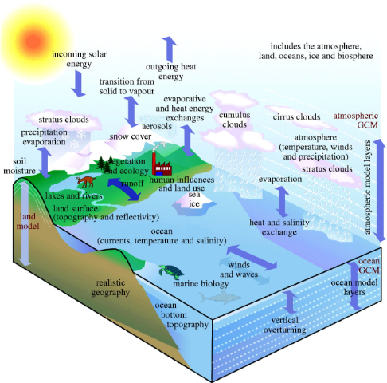
Data source
Simulation
Machine generated from test models
Likely to be reproducible if the model and inputs are preserved
Examples: climate models, economic models,

Slide 8
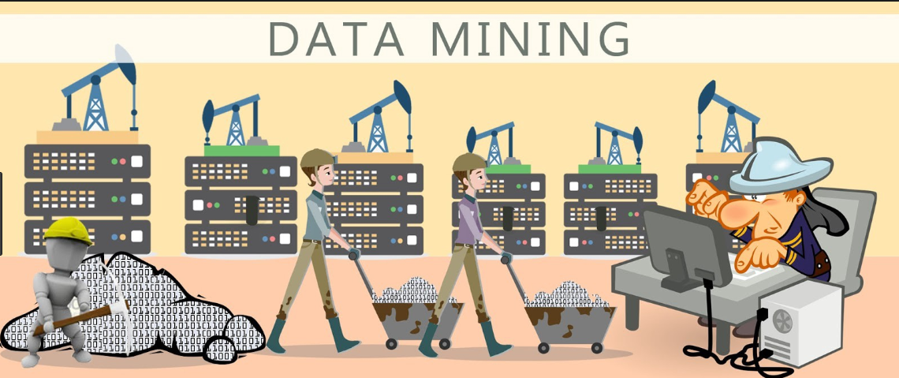
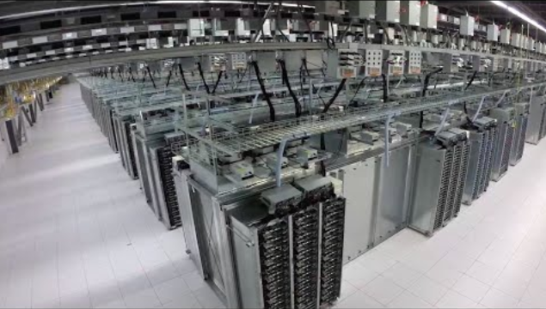
Data source
Derived / Compiled
Generated from existing datasets
Reproducible, but can be very expensive and time-consuming
Examples: text and data mining, compiled database, 3D models

Slide 9
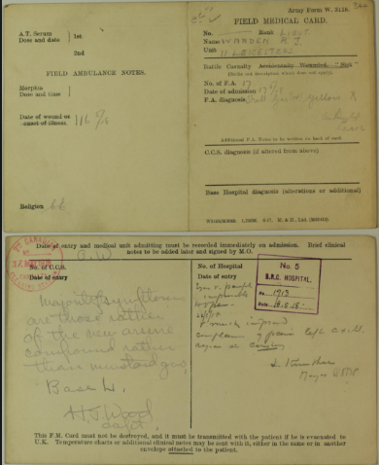
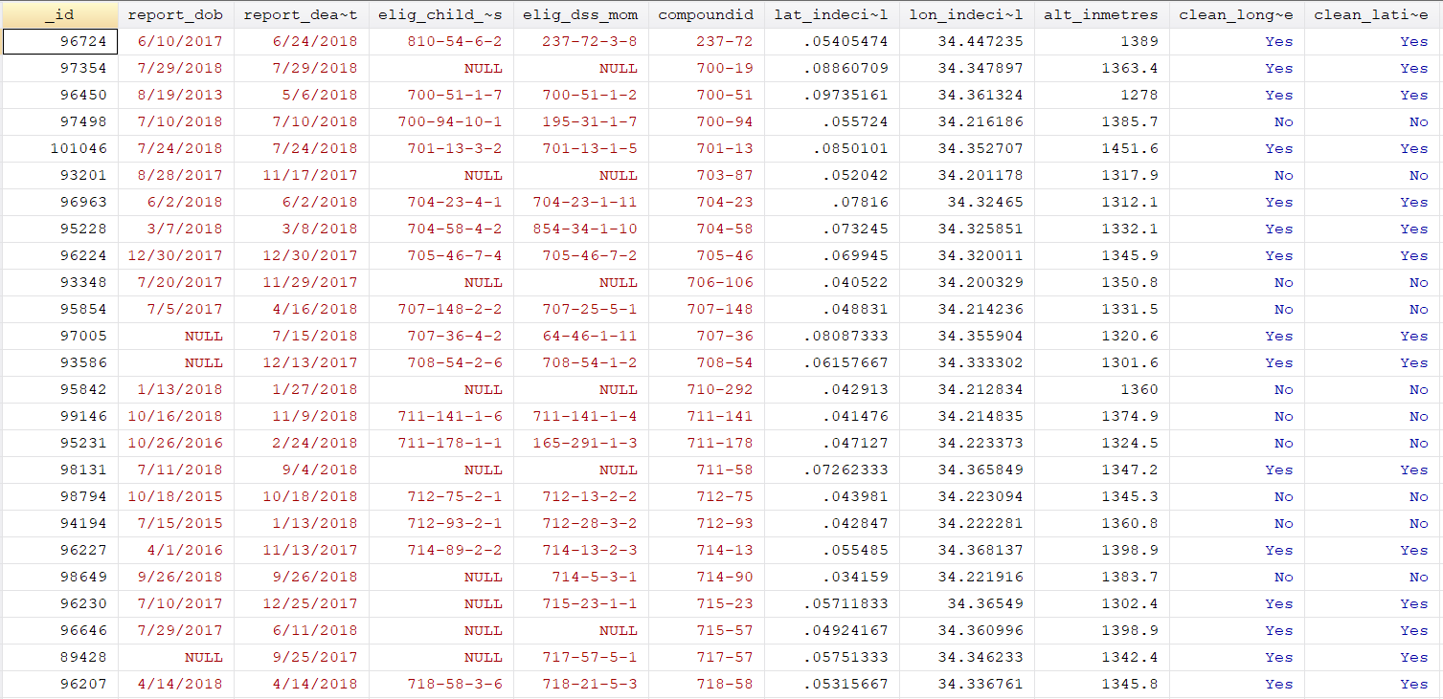
Data FORMAT
Data can come in many forms, including:
Text: field or laboratory notes, survey responses
Numeric: tables, counts, measurements

Slide 10
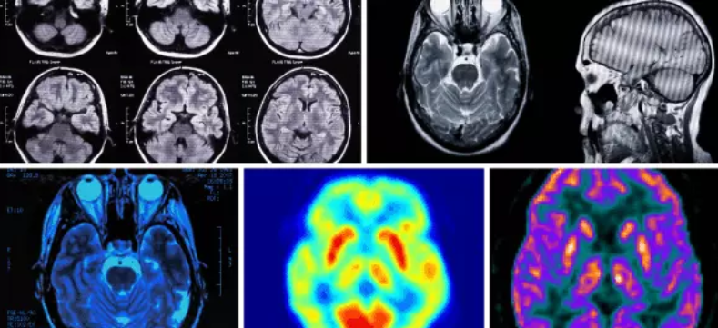
Data FORMAT
Data can come in many forms, including:
Audiovisual: images, sound recordings, video

Slide 11
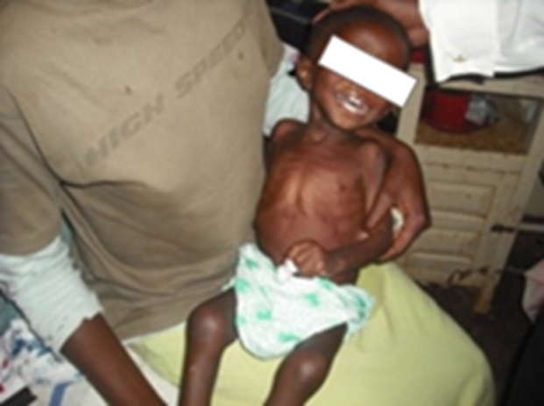
Data FORMAT
Data can come in many forms, including:
Audiovisual: images, sound recordings, video

Slide 12
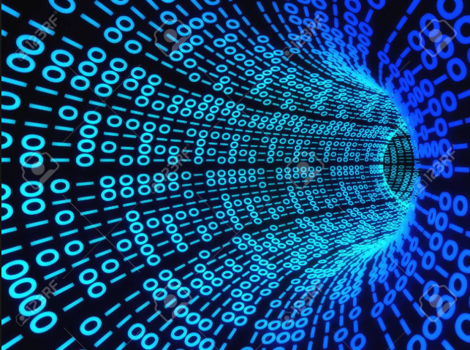
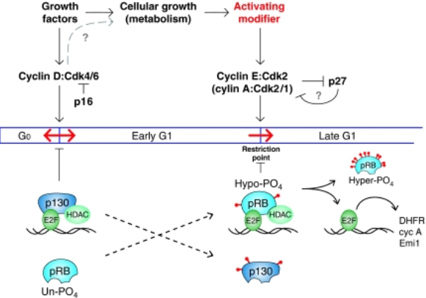
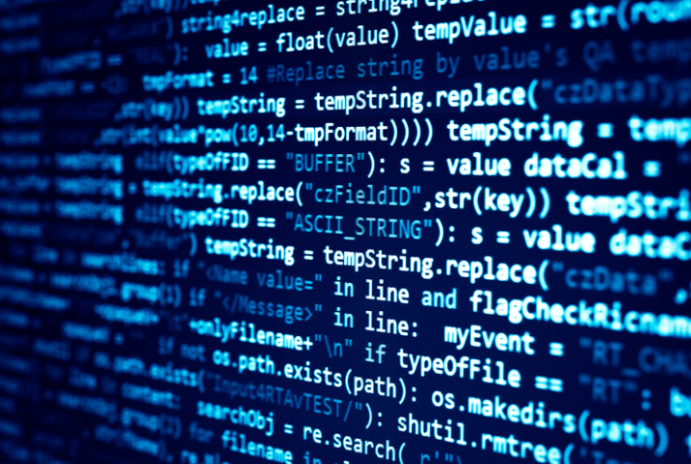
Data FORMAT
Data can come in many forms, including:
Models, computer code

Slide 13
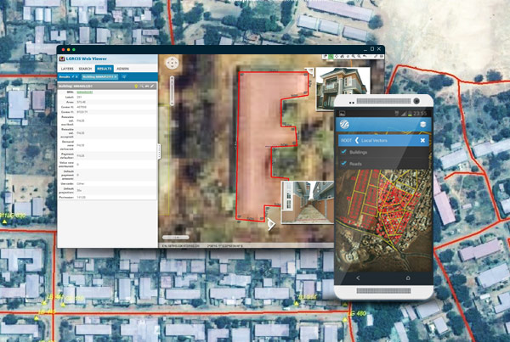
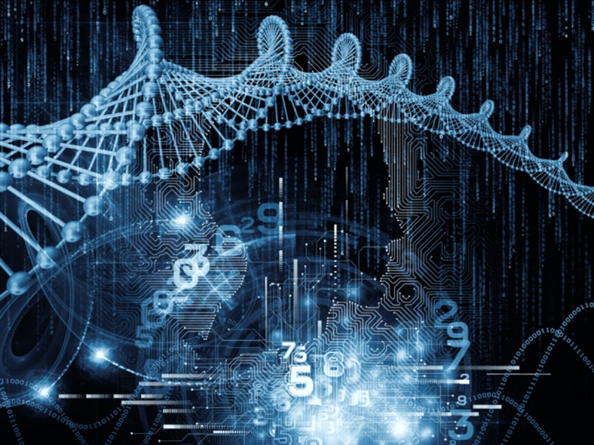
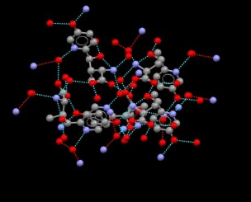
Data FORMAT
Data can come in many forms, including:
Discipline-specific: raster in Geographical Information Systems, CIF in chemistry, genomic

Slide 14
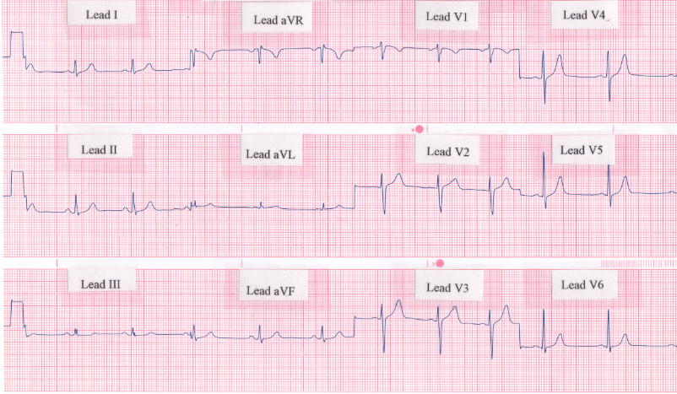
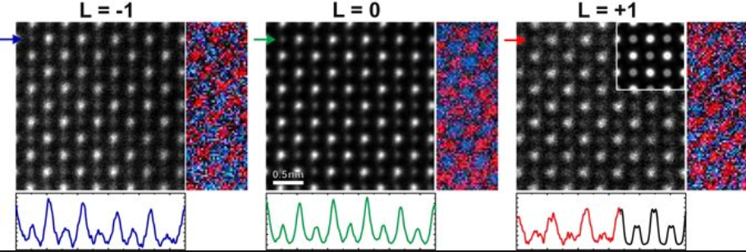
Data FORMAT
Data can come in many forms, including:
Instrument-specific: ECG outputs, electron microscopy

Slide 15

Data stability/permanence
How stable is the data?
Data can also be fixed or changing over the course of the project (and perhaps beyond the project's end) - Do the data ever change? - Do they grow? - Is previously data subject to correction? - Need to keep track of data versions?

Slide 16
Data stability/permanence
With respect to time, we consider:
Fixed datasets: never change after being collected or generated e.g.?
Growing datasets: new data may be added, but the old data is never changed or deleted e.g.?
Revisable datasets: new data may be added, and old data may be changed or deleted e.g.?
Keeping track of rapidly changing datasets can be a challenge so it is imperative that you begin with a plan to carry you through the entire data management process.

Slide 17

Data volume/size
Data size varies: - e.g. image data requires a lot of storage space, so you'll want to decide whether to retain all your images (and, if not, how you will decide which to discard) and where such large data can be housed.
Be sure to know your archiving organization's capacity for storage and backups.

Slide 18
Data volume/size
To avoid being under-prepared, estimate the growth rate of your data. You need to consider the following:
Are you manually collecting and recording data?
What instruments /device/computers are used to collect data?
Is your data collection highly iterative?
How much data will you accumulate every month or every 90 days?
How much data do you anticipate collecting and generating by the end of your project?

Slide 19
Data collection methods…..practical
Based on the above discussion and your experience……. - what are the relevant data collection methods and techniques?
Brief list of these!

Slide 20
Acknowledgements

